Slide 1
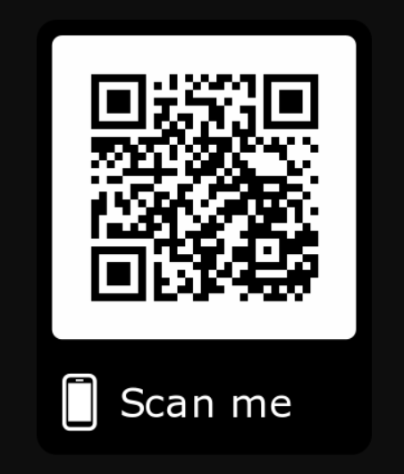
Before we start…..
Please go to https://github.com/zoeytxc/PyLadiesCrashCourse
To download the following files:
Exercise1.txt Exercise2.txt TopSecret.txt
Module1.ipynb Module2.ipynb
Search&Sort Tutorial.ipynb
Then please proceed to try.jupyter.com and inform our facilitators after you finished this.

Slide 2
Hello, Python
Crash course on python basics

Slide 3

PyLadies
Level 1: Beginner

Slide 4
Content for Module 1
Python Terminologies
Basic Operations
Conditional Statements
For and While Loops
String Operation

Slide 5
Introduction
 | Variables | Keywords
Purpose | Labels to store values | Reserved words in python
Example | pear= “delicious” number_of_pear= 10 | and is if

Slide 6
Assigning Variables
num = 13
variable name assignment operator value
Notes:
Num lo = 13

Slide 7
Basic Operations

Slide 8
Comparative Operators
= | assigning value to variable
== | checks for equality
!= | not equal
< | less than
<= | less than or equal to
> | more than
>= | more than or equal to

Slide 9
Mathematical Operators
+ | Add
- | Subtract
* | Multiply
** | Exponent
/ | Divide
// | Quotient
% | Remainder
NOTE: Python will follow BODMAS rule

Slide 10
Identity, Membership Operators
is | True if operands are identical | >>x=5 >>x is 5 True
is not | True if operands are NOT identical | >>x=5 >>x is not 5 False
in | True if it is in sequence | x= [1,3,5] >>3 in x True
not in | True if it is NOT in sequence | >>3 not in x False

Slide 11
Common Reserved Keywords
is | True if operands are identical | >>x=5 >>x is 5 True
is not | True if operands are NOT identical | >>x=5 >>x is not 5 False
in | True if it is in sequence | x= [1,3,5] >>3 in x True
not in | True if it is NOT in sequence | >>3 not in x False

Slide 12
Data Types
Data Types
Immutable
Mutable
Numbers
Strings
Tuples
Lists
Dictionaries
Sets

Slide 13
Data Types- Number
⇒ int(): integer
eg. 1, 4
4 + 2 =6
2**3= 8
⇒ float(): numbers with fractional parts/decimals
eg. 3.5, 6.0
2.0 + 5 = 7.0
6 / 3 = 2.0

Slide 14
Data Types- Strings
⇒ str(): strings; sequences of one-character strings
Eg. ‘Hello’ , “Hello”

Slide 15
String Operations
Concatenation
“Python” + “Tutorial” = “PythonTutorial”
Repetition
“Ladies” * 2 = “LadiesLadies”
Slicing
string1 = “Saturday”
string1[1:6]
>> “aturda”
Indexing
string1 = “Saturday”
string1[0]
>> “S”

Slide 16
Data Types- Tuples
⇒ Tuple= (“24 March”, “PyLadies”, 3)
Sequence of immutable Python objects (strings, floats, etc.)
Can’t be changed
Defined using curve brackets ( )

Slide 17
Data Types
Data Types
Immutable
Mutable
Numbers
Strings
Tuples
Lists
Dictionaries
Sets

Slide 18
Data Types- List
Sequence of mutable Python objects (strings, floats, etc.)
Can be changed
Defined using square brackets [ ]
⇒ List= [“24 March”, “PyLadies”, 3]

Slide 19
List Specific Methods
len(x).
.append(y)
.pop(y)

Slide 20
Data Types- Dictionaries
Items are stored and fetched by keys
⇒ Dict= {1: “Mary”, 2: “Sarah”, 3: “Sally”}
Key Value

Slide 21
Dictionary Specific Methods
Dict= {1:”apple”, 2:”ball”}
Accessing Dictionary
Dict[1] → “apple”
len()
len(Dict) → 2
key()
Dict.key() → [1,2]
values()
Dict.values → [“apple”, “ball”]

Slide 22
Data Types- Sets
A set is an unordered collection of items
Every element is unique and immutable
⇒ Set= {1,2,3}

Slide 23
Conditional Statements

Slide 24
Conditional Statements- if/else
⇒ if condition stated is fulfilled, action will be executed.
if <condition1>:
<action1>
elif <condition2>:
<action2>
...
else:
<actionk>

Slide 25
Conditional Statements- and/or
⇒ and both conditions MUST be satisfied for result to be True
⇒ or at least one condition MUST be satisfied for result to be True

Slide 26
Conditional Statements: Eg.
E.g. a = 3
b = 9
if a < b:
print("a is less than b")
elif a == b and a!=0:
print("a is equal to b")
else:
print("a is greater than b")
NOTE: elif is for when you need to state more conditions

Slide 27
Loops

Slide 28
Loops
⇒ Used to repeat a fixed pattern
For Loop | While Loop
Repeats code a finite number of times | Repeats when condition is true, terminates when false
E.g. compute sum of 1 to 10 total = 0 for i in range (1,11): total = total + i print(total) | E.g. compute sum of 1 to 10 total = 0 n = 1 while n <= 10: total = total + n n = n + 1 print(total)

Slide 29
PyLadies
Level 2: Functions & File Operation

Slide 30
File Operation
Why do we need that?
Departure from Standard I/O
Manual input to Automatic input
Output to files for long-time record

Slide 31
Understanding the process
Link between your code and the file
Open the file for I/O
Data Retrieve
Data Processing
Modification of File
Close the file

Slide 32
Implementation in Python
infile = open(<input file name>, 'r'/'w'/’a’)
#r for read, w for write, a for append
#most common operations
lines = infile.readlines() #read from file
for line in lines:
print(line)
infile.write(<content into the file>) #write/append to file
Seems Easy? Your turn to try!!

Slide 33
infile = open('Exercise1.txt','r')
lines = infile.readlines()
for line in lines:
line = line.rstrip('\n')
print(line)
infile.close()

Slide 34
Oppps the message is encoded.. But we know the trick!
There are 2 numbers on each line, separated by a comma
E.g. 23,6
The first number denotes a letter
Number of prime number smaller than it: 8
2,3,5,7,11,13,17,19
It denotes the 8th letter in alphabetical order: h
The second number denotes the position of the letter in the sentence.
Try to decode the message!

Slide 35
Testing for prime numbers
n = number to be tested
IsPrime = True
for i in range(1,n):
if n % i == 0:
IsPrime == False
Break
There is a small bug inside the code.
Can you find out where is it?

Slide 36
Subroutine: Functions and Procedure
What is subroutine?
Why do we need subroutines?
How do we implement it in Python?

Slide 37
Subroutine
just like a program
It performs a specific task and is packaged as a single unit to form a subprogram.
This subroutine can then be used at any point in the main program, whenever the task has to be performed.
A subroutine may have parameters for input data required in its processing.

Slide 38
Subroutine
Functions
Procedure

Slide 39
Starting from sample code
Parameter intake
def Readfiles(FileName,Function,Content = None):
if Function == 'Read':
infile = open(FileName,'r')
lines = infile.readlines()
return lines
elif Function == 'Write':
outfile = open(FileName,'w')
outfile.write(Content,'\n')
return 0
else:
outfile = open(FileName,'a')
outfile.write(Content)
return 0
Default value of there is no input
Return values

Slide 40
Your turn to try

Slide 41
PyLadies
Level 3: Search and Sort Algorithms

Slide 42
Search & Sort
Simplify problems
Main building blocks of programming
Applicable in many real life scenarios

Slide 43
What we will be teaching today
Linear search
Insertion sort
Bubble sort

Slide 44
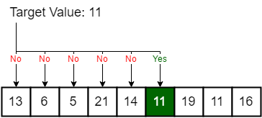
Linear Search
#good when the search target is in front def linear_search(array,target): for index in range(len(array)): if array[index] == target: return index return -1
# main array = [13,6,5,21,14,11,19,11,16] print(linear_search(array,5))

Slide 45
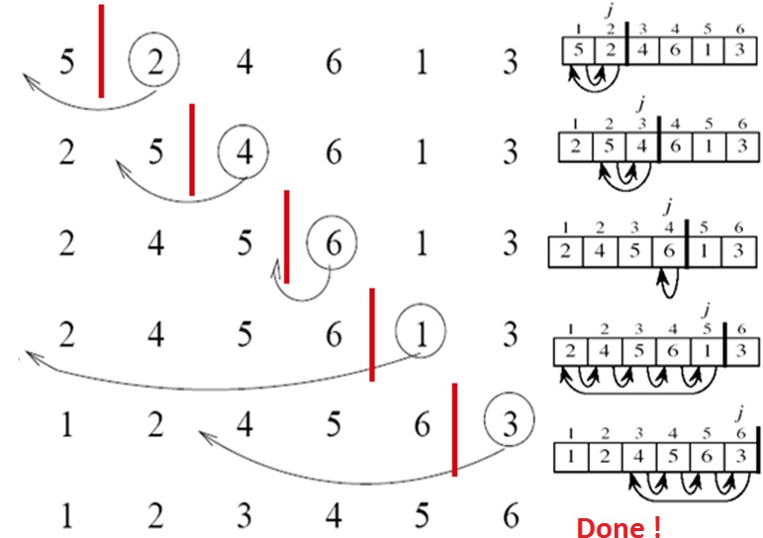
Insertion Sort

Slide 46
Insertion Sort
def insertion_sort(array): for j in range(1,len(array)): #assume first item sorted num = array[j] i = j - 1 while (i >= 0 and array[i] > num): array[i+1] = array[i] i = i - 1 array[i+1] = num return array
#main array = [5,2,4,6,1,3] print(insertion_sort(array))

Slide 47
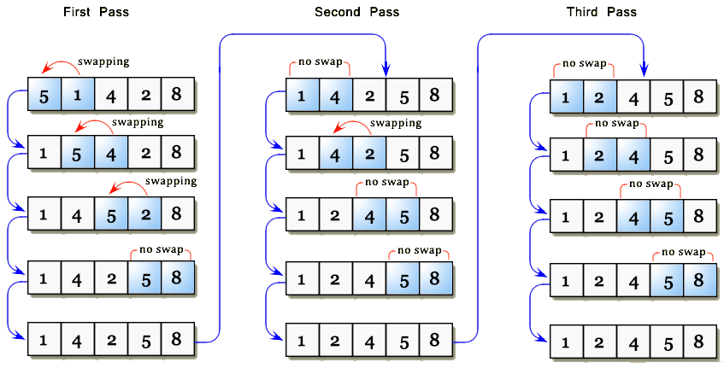
Bubble Sort

Slide 48
Bubble Sort
This algorithm is different from what is reflected in the previous image. Do you know why?
Which one is more efficient?
def bubble_sort(arr):
# Traverse through all array elements
for i in range(len(arr)):
# Last i elements are already in place
for j in range(len(arr)-i-1):
# traverse the array from 0 to n-i-1
if arr[j] > arr[j+1] :
arr[j], arr[j+1] = arr[j+1], arr[j]
return arr
#main array = [5,1,4,2,8] print(bubble_sort(array))

Slide 49
Pyladies Out.

